Slide 1
Monitoring and Analytics
Module 7
Notes:
In this module, you will learn about three services for monitoring and analyzing your AWS environment: Amazon CloudWatch, AWS CloudTrail, and AWS Trusted Advisor.

Slide 2

Module 7 objectives
In this module, you will learn how to:
Summarize approaches to monitoring in AWS
Describe Amazon CloudWatch benefits
Describe AWS CloudTrail benefits
Describe AWS Trusted Advisor benefits
Notes:
In this module, you will learn how to:
Summarize approaches to monitoring in AWS
Describe Amazon CloudWatch benefits
Describe AWS CloudTrail benefits
Describe AWS Trusted Advisor benefits

Slide 3
Amazon CloudWatch
Notes:
Throughout this course, you have explored topics such as creating AWS resources, delivering content to your customers, and keeping your environment secure.
This module focuses on the topics of monitoring and analytics. Monitoring and analyzing your AWS infrastructure can help you optimize usage, identify actions that require an immediate response, and refine business processes.
The first monitoring service that you will examine is Amazon CloudWatch. The next section begins with an example from the coffee shop.

Slide 4


Coffee shop metrics
Metrics
Thresholds
Actions
Average customer wait time over the past hour
Greater than 5 minutes
Open another register
Number of remaining pastries for sale
Fewer than 10 pastries
Bake another batch of pastries
Notes:
Whenever the owner is in the coffee shop, they monitor how the business is operating throughout the day. For example, they calculate the average customer wait time over the past hour and identify the number of remaining pastries for sale. These are examples of metrics. You can think of a metric as a variable that is monitored for a resource.
The owner monitors these metrics and notices if any of them happen to exceed or fall below specific thresholds. If any areas require immediate action, the owner can respond to them right away.
For instance, whenever the owner notices that the average customer wait time exceeds 5 minutes, they open another register. Whenever the owner notices that only 10 pastries are remaining, they bake another batch.
However, going back and forth between workstations to observe them one at a time is not feasible for the owner. The owner needs a system that they can use to monitor multiple parts of the coffee shop at once, receive a notification if any metrics exceed or fall below specific thresholds, and automatically respond to performance or usage issues.
The next section explores how you can use Amazon CloudWatch to monitor your AWS resources and configure automatic actions for them.

Slide 5



Amazon CloudWatch
Monitor your AWS and on-premises infrastructure and resources in real time
Access all of your metrics from a single location
Configure automatic alerts and actions in response to metrics
Notes:
Amazon CloudWatch is a web service that allows you to monitor and manage various metrics, and configure alarm actions based on data from those metrics.
CloudWatch uses metrics to represent the data points for your resources. AWS services send metrics to CloudWatch. CloudWatch uses the metrics to create graphs automatically that show how performance has changed over time.
With CloudWatch, you can create alarms that automatically perform actions if the value of a metric goes above or below a predefined threshold.
For example, suppose that your company’s developers use Amazon Elastic Compute Cloud (Amazon EC2) instances for application development or testing purposes. If the developers occasionally forget to stop the instances, the instances will continue to run and incur charges.
In this scenario, you could create a CloudWatch alarm that automatically stops an Amazon EC2 instance when the CPU usage percentage has remained below a certain threshold for a specified period. When configuring the alarm, you can specify to receive a notification whenever the alarm is triggered.
The next section explores an example of how data is presented in a CloudWatch dashboard.

Slide 6
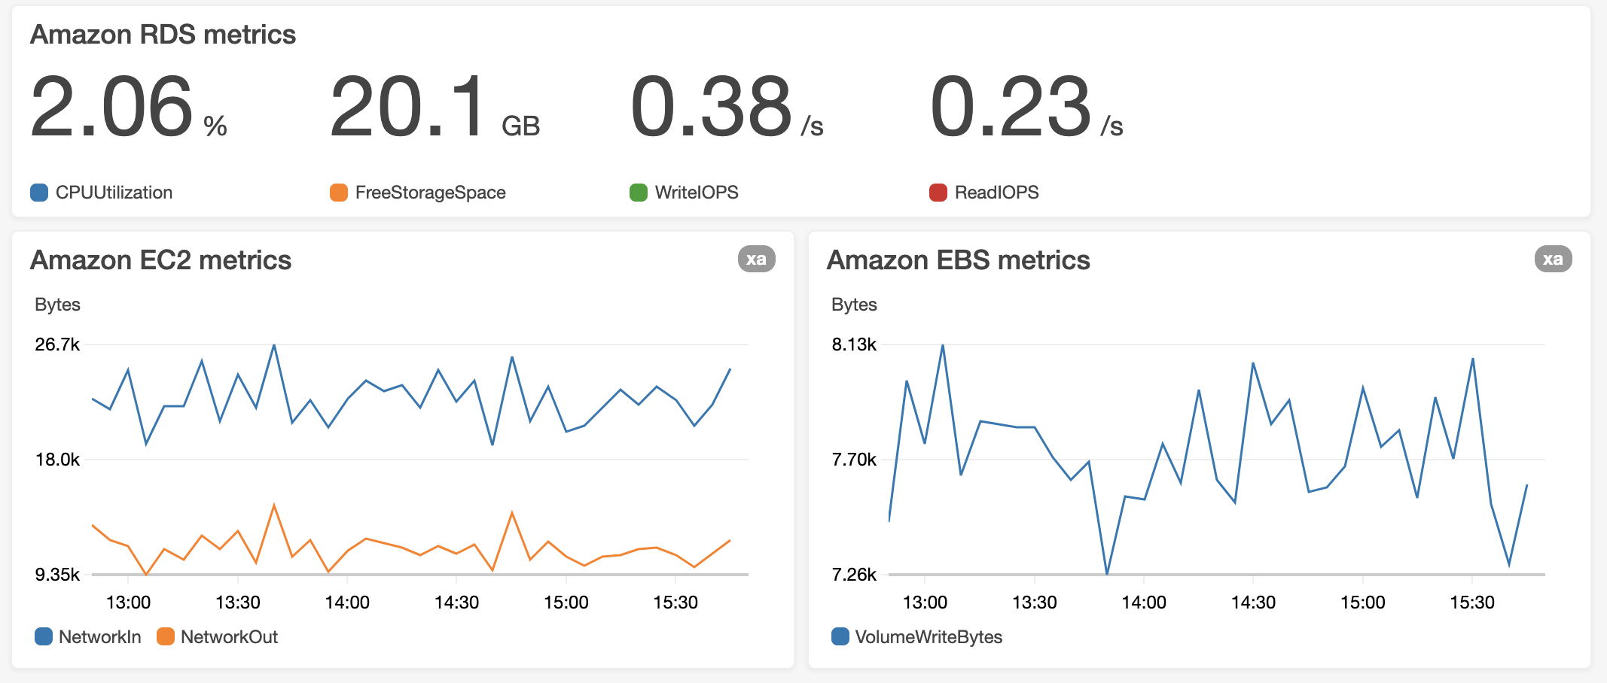
Amazon CloudWatch dashboard
Notes:
Consider this example. Suppose that the coffee shop has an application that uses Amazon Relational Database Service (Amazon RDS) instances, Amazon EC2 instances, and Amazon Elastic Block Store (Amazon EBS) volumes.
The coffee shop owner uses the CloudWatch dashboard feature to access all the metrics for their resources from a single location. For example, they can use a CloudWatch dashboard to monitor the CPU usage of an Amazon EC2 instance, the total number of requests made to an Amazon Simple Storage Service (Amazon S3) bucket, and more. They can even customize separate dashboards for different business purposes, applications, or resources.

Slide 7
AWS CloudTrail
Notes:
In addition to monitoring the performance of AWS resources, you might also want to track all the user actions and API requests that occur throughout your AWS environment.
The service that provides this functionality is AWS CloudTrail. To learn about CloudTrail, the next section explores another example from the coffee shop.

Slide 8
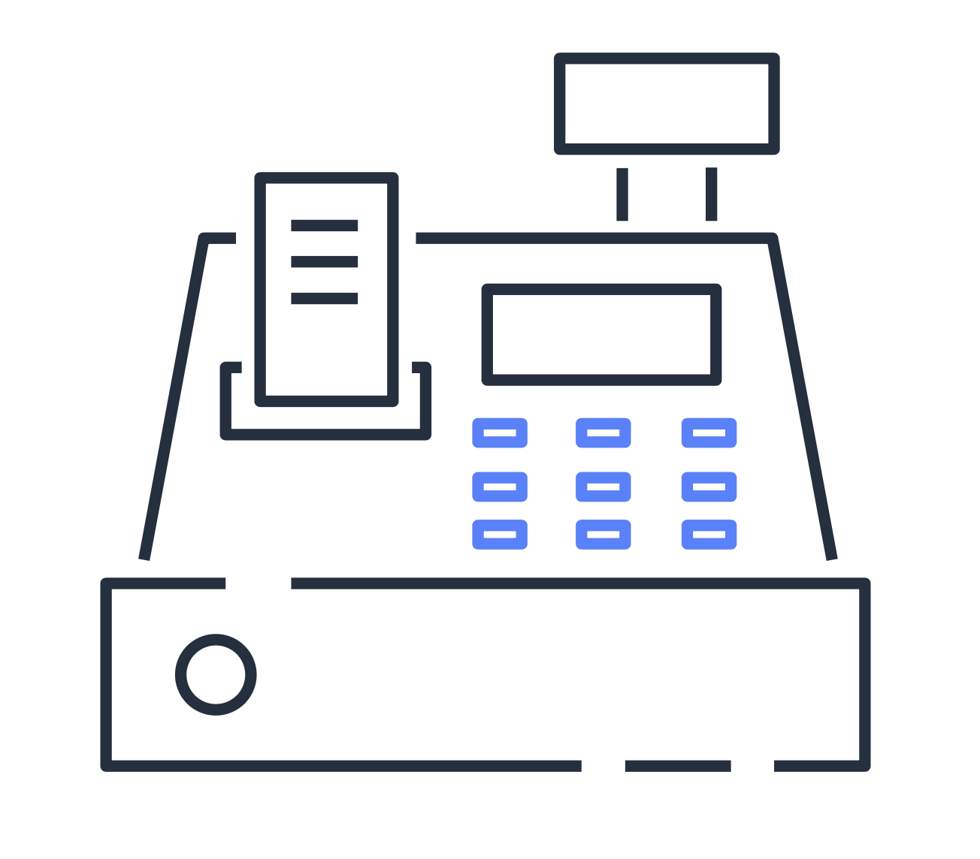


Coffee shop events
3 days ago
2 days ago
Today
The cashiers process a large number of transactions.
To avoid running out of supplies, the inventory specialist places an extra order.
A shipment of coffee beans is delivered to the coffee shop.
Notes:
One day at the coffee shop, the owner receives an unexpected delivery of coffee beans. The regular shipment isn’t scheduled to arrive for another week, so the owner is unsure why this shipment of coffee beans has arrived now.
The owner retraces events that occurred over the past few days. They check the inventory system and discover that the inventory specialist placed an order for coffee beans two days ago.
Next, the owner reviews the transaction logs from the point of sale system. They discover that due to an unexpected increase in business three days ago, the shop was forecasted to run out of coffee beans before its next shipment. This is why the inventory specialist needed to place an additional order.
Reviewing the coffee shop’s event history can help the owner answer questions about which actions were taken, when they occurred, and which users or resources were involved.
To review activities that occur throughout your AWS environment, you can use AWS CloudTrail.

Slide 9



AWS CloudTrail
Track user activities and API requests throughout your AWS infrastructure
Filter logs generated by API calls to assist with operational analysis and troubleshooting
Automatically detect unusual account activity
Notes:
AWS CloudTrail records API calls for your account. The recorded information includes the identity of the API caller, the time of the API call, the source IP address of the API caller, and more. You can think of CloudTrail as a “trail” of breadcrumbs (or a log of actions) that someone left behind them.
Recall that you can use API calls to provision, manage, and configure your AWS resources. With CloudTrail, you can view a complete history of user activity and API calls for your applications and resources.
Events are typically updated in CloudTrail within 15 minutes after an API call. You can filter events by specifying the time and date that an API call occurred, the user who requested the action, the type of resource involved in the API call, and more.
In CloudTrail, you can also enable CloudTrail Insights. This optional feature allows CloudTrail to automatically detect unusual API activities in your AWS account.
For example, CloudTrail Insights might detect that a higher number of Amazon EC2 instances than usual have recently launched in your account. You can then review the full event details to determine which actions you must take.
Next, you will review an example of how the coffee shop might use AWS CloudTrail.

Slide 10




AWS CloudTrail event
What happened?
New IAM user (Mary) created
IAM user John
When did this occur?
January 1, 2021 at 9:00 AM
How was the request made?
Through the AWS Management Console
Who made the request?
Notes:
Suppose that the coffee shop owner is browsing through the AWS Identity and Access Management (IAM) section of the AWS Management Console. They discover that a new IAM user named Mary was created, but they do not know who, when, or which method created the user.
To answer these questions, the owner navigates to AWS CloudTrail.
In the CloudTrail Event History section, the owner applies a filter to display only the events for the “CreateUser” API action in IAM. The owner locates the event for the API call that created an IAM user for Mary. This event record provides complete details about what occurred:
On January 1, 2021 at 9:00 AM, IAM user John created a new IAM user (Mary) through the AWS Management Console.

Slide 11

Knowledge check question
Which tasks can you perform using AWS CloudTrail? (Select TWO.)
Monitor your AWS infrastructure and resources in real time
Track user activities and API requests throughout your AWS infrastructure
View metrics and graphs to monitor the performance of resources
Filter logs to assist with operational analysis and troubleshooting
Configure automatic actions and alerts in response to metrics
Notes:
Which tasks can you perform using AWS CloudTrail? (Select TWO.)
Monitor your AWS infrastructure and resources in real time
Track user activities and API requests throughout your AWS infrastructure
View metrics and graphs to monitor the performance of resources
Filter logs to assist with operational analysis and troubleshooting
Configure automatic actions and alerts in response to metrics

Slide 12
Knowledge check answer
Which tasks can you perform using AWS CloudTrail? (Select TWO.)
Monitor your AWS infrastructure and resources in real time
Track user activities and API requests throughout your AWS infrastructure (correct)
View metrics and graphs to monitor the performance of resources
Filter logs to assist with operational analysis and troubleshooting (correct)
Configure automatic actions and alerts in response to metrics
Notes:
The two correct response options are:
B. Track user activities and API requests throughout your AWS infrastructure
D. Filter logs to assist with operational analysis and troubleshooting
The other response options are tasks that you can perform in Amazon CloudWatch.

Slide 13
AWS Trusted Advisor
Notes:
Next, you will examine how to use data and insights about your AWS resources to identify potential areas of improvement.
A service that provides recommendations for improving your AWS environment is AWS Trusted Advisor. The next section uses a coffee shop example to introduce you to Trusted Advisor.

Slide 14

Coffee shop improvements
The consultant observes the coffee shop.
The consultant makes recommendations for improvement.
The owners implement the suggested changes.
Notes:
Now that the coffee shop has been in business for a while, the owners want to improve their operations. They enlist the help of a coffee shop consultant.
The consultant observes the coffee shop’s current business practices, such as order-taking processes, use of supplies, methods for securing digital records, and so on. The consultant compares their observations to established best practices for running a coffee shop.
As the consultant completes their observations, they provide the owners with a summary of their findings and their recommended areas of improvement. This allows the owners to more easily begin making specific changes throughout the shop. Later, the owners can invite the consultant to come back to conduct additional observations and determine which other improvements might benefit the coffee shop.
To receive real-time guidance for how to make improvements throughout your AWS environment, you can use AWS Trusted Advisor.

Slide 15



AWS Trusted Advisor
Receive real-time guidance for improving your AWS environment
Compare your infrastructure to AWS best practices in five categories
Evaluate and implement guidance at all stages of deployment
Notes:
AWS Trusted Advisor is a web service that inspects your AWS environment and provides real-time recommendations in accordance with AWS best practices.
Trusted Advisor compares its findings to AWS best practices in five categories: cost optimization, performance, security, fault tolerance, and service limits. For the checks in each category, Trusted Advisor offers a list of recommended actions and additional resources to learn more about AWS best practices.
The guidance provided by AWS Trusted Advisor can benefit your company at all stages of deployment. For example, you can use AWS Trusted Advisor to assist you while you are creating new workflows and developing new applications. Or, you can use it while you are making ongoing improvements to existing applications and resources.

Slide 16


AWS Trusted Advisor dashboard
Number of items for which no problems have been detected
Number of recommended investigations
Number of recommended actions
Notes:
When you access the Trusted Advisor dashboard in the AWS Management Console, you can review completed checks for cost optimization, performance, security, fault tolerance, and service limits, as shown in this example.
For each category:
The green check indicates the number of items for which it detected no problems.
The orange triangle represents the number of recommended investigations.
The red circle represents the number of recommended actions.
Here are a few examples of what these alerts might indicate for Trusted Advisor’s checks in Amazon S3:
A yellow investigation alert might occur if a bucket’s access control list allows any authenticated AWS user to view the objects in the bucket.
A red action alert might occur if a bucket’s access control list allows any authenticated AWS user to upload files to the bucket or delete existing objects.
Although both of these alerts should be remediated, the red alert indicates a greater sense of urgency for action that needs to be taken.

Slide 17
Knowledge check
Module 7
Notes:
There are no notes on this slide.

Slide 18
Knowledge check question 1
Which actions can you perform using Amazon CloudWatch? (Select TWO.)
Monitor your resources’ usage and performance
Receive real-time guidance for improving your AWS environment
Compare your infrastructure to AWS best practices in five categories
Access metrics from a single dashboard
Automatically detect unusual account activity
Notes:
Which actions can you perform using Amazon CloudWatch? (Select TWO.)
Monitor your resources’ usage and performance
Receive real-time guidance for improving your AWS environment
Compare your infrastructure to AWS best practices in five categories
Access metrics from a single dashboard
Automatically detect unusual account activity

Slide 19
Knowledge check answer 1
Which actions can you perform using Amazon CloudWatch? (Select TWO.)
Monitor your resources’ usage and performance (correct)
Receive real-time guidance for improving your AWS environment
Compare your infrastructure to AWS best practices in five categories
Access metrics from a single dashboard (correct)
Automatically detect unusual account activity
Notes:
The two correct response options are:
A. Monitor your resources’ usage and performance
D. Access metrics from a single dashboard
The other response options are incorrect because:
B. Receiving real-time recommendations for improving your AWS environment can be performed by AWS Trusted Advisor.
C. Comparing your infrastructure to AWS best practices in five categories can be performed by AWS Trusted Advisor.
E. Automatically detecting unusual account activity can be performed by AWS CloudTrail.

Slide 20
Knowledge check question 2
Which service can you use to review the security of your Amazon S3 buckets by checking for open access permissions?
Amazon CloudWatch
AWS CloudTrail
AWS Trusted Advisor
Amazon GuardDuty
Notes:
Which service can you use to review the security of your Amazon S3 buckets by checking for open access permissions?
Amazon CloudWatch
AWS CloudTrail
AWS Trusted Advisor
Amazon GuardDuty

Slide 21
Knowledge check answer 2
Which service can you use to review the security of your Amazon S3 buckets by checking for open access permissions?
Amazon CloudWatch
AWS CloudTrail
AWS Trusted Advisor (correct)
Amazon GuardDuty
Notes:
The correct response option is C. AWS Trusted Advisor.
AWS Trusted Advisor is a web service that inspects your AWS environment and provides real-time recommendations in accordance with AWS best practices. The inspection includes security checks, such as Amazon S3 buckets with open access permissions.
The other response options are incorrect because:
A. Amazon CloudWatch is a web service that allows you to monitor and manage various metrics for the resources that run your applications.
B. AWS CloudTrail is a web service that allows you to review details for user activities and API calls that have occurred in your AWS environment.
D. Amazon GuardDuty is a service that provides intelligent threat detection for your AWS environment and resources. It identifies threats by continuously monitoring the network activity and account behavior in your AWS environment.

Slide 22
Knowledge check question 3
Which categories are included in the AWS Trusted Advisor dashboard? (Select TWO.)
Reliability
Performance
Scalability
Elasticity
Fault tolerance
Notes:
Which categories are included in the AWS Trusted Advisor dashboard? (Select TWO.)
Reliability
Performance
Scalability
Elasticity
Fault tolerance

Slide 23
Knowledge check answer 3
Which categories are included in the AWS Trusted Advisor dashboard? (Select TWO.)
Reliability
Performance (correct)
Scalability
Elasticity
Fault tolerance (correct)
Notes:
The two correct response options are:
B. Performance
E. Fault tolerance
AWS Trusted Advisor continuously inspects your AWS environment and provides best practice recommendations across five categories: cost optimization, performance, security, fault tolerance, and service limits.

Slide 24
Module 7 summary
In this module, you learned about:
Amazon CloudWatch
AWS CloudTrail
AWS Trusted Advisor
Notes:
In this module, you learned about three AWS services for monitoring and analytics:
Amazon CloudWatch is a service that monitors usage and performance for the resources that run your applications.
AWS CloudTrail is a service that you can use to review details for user activities and API requests that occur in your AWS environment.
AWS Trusted Advisor is a service that scans your infrastructure and provides real-time guidance in accordance with AWS best practices.
In the next module, you will explore AWS pricing and support.

